Slide 2
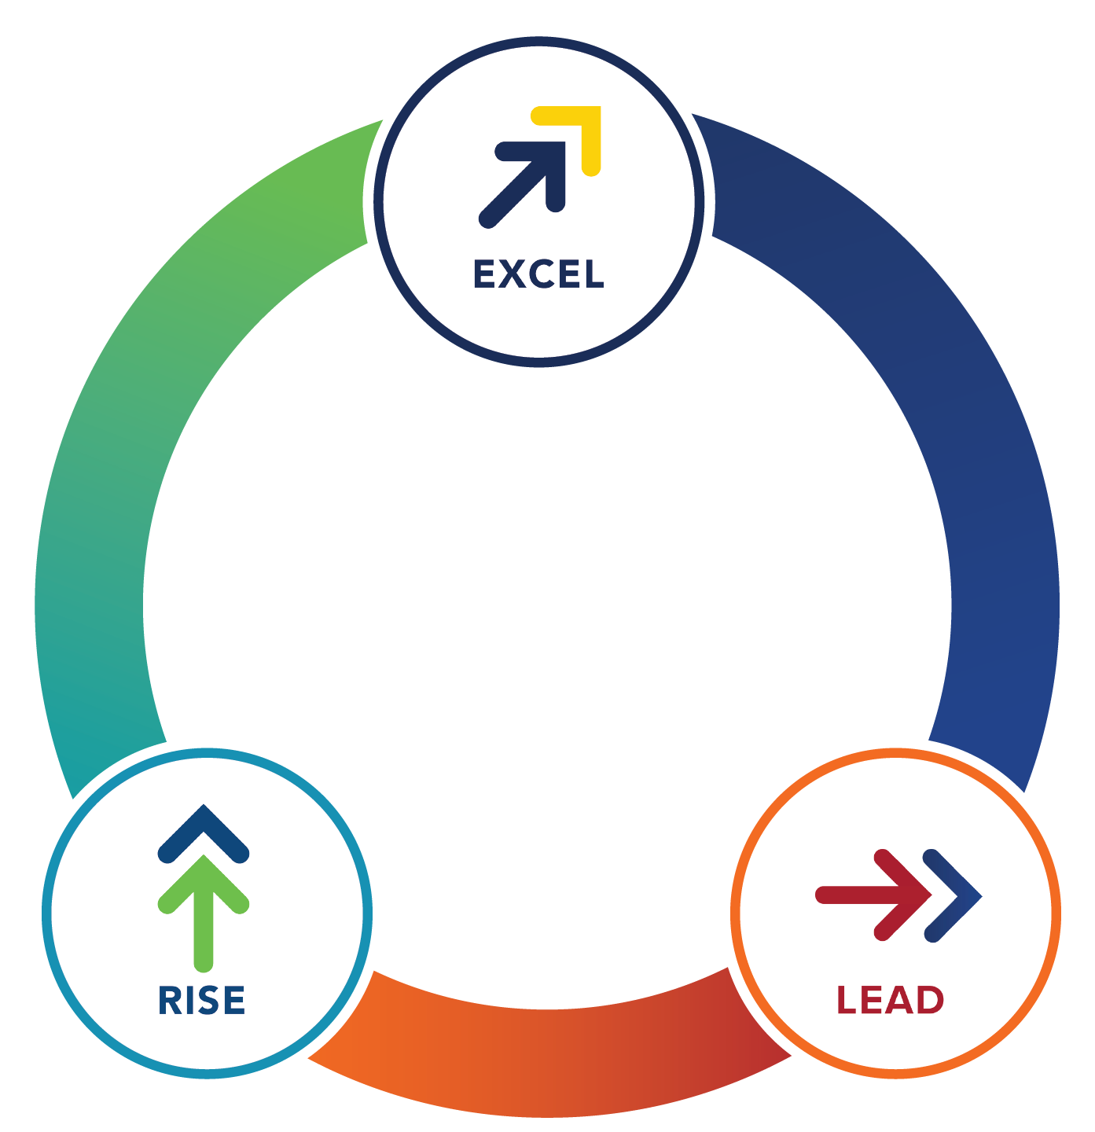
The MDRT Family of Brands
Equips financial services professionals to Rise. Excel. Lead. Throughout every stage of their career journey.

Slide 3
What is the mission of the MDRT Center for Field Leadership?
The MDRT Center for Field Leadership was founded by MDRT as a membership association specifically for field and home office leaders that fosters a culture of continuous improvement and learning.
As field and home office leaders join and engage with the MDRT Center for Field Leadership, they will accelerate their growth, build an MDRT culture of excellence, increase productivity, connect with other leaders, and learn from content and tools developed specifically for them to take their teams to the next level.
Membership
Requirements
Field or home office leaders in financial services (currently available in English only)
Join anytime
Open enrollment is November 1 to April 1, annually

Slide 4
“Center for Field Leadership study groups are incredibly important conversations. They’re meaningful to how we do our business. It’s so rewarding. I’m thankful to be a [study group] leader. Study group leaders become better managers by virtue of this role. It keeps you sharp.
Jason C. Staas, FICS, M.S.

Slide 5
Benefits to your business:
Effective team management gained through enhanced skills and expertise
Improved team morale and productivity
Increased retention and career satisfaction
Enhanced competency and confidence to spearhead and manage organizational change
Significant personal, professional and overall team performance
Global recognition as your teams achieve unique standards of excellence in pursuit of an MDRT Culture of Excellence Award

Slide 6
Benefits to your leaders:
Expert instruction and certification through the Harvard ManageMentor® platform
Recognition based on high-level team performance, while achieving global standards of excellence in business and community
Best-in-class toolkits and learning resources to guide and facilitate your team leaders’ journeys
Close-knit learning communities and study groups with peers to help increase productivity and persistency
Exposure to the greater MDRT membership community and thought leaders while attending the MDRT Annual Meeting or MDRT Global Conference

Slide 7
Exclusive content:
MDRT Center for Field Leadership members have access to articles, videos and Webcasts to guide them along their leadership journeys, as well as the monthly Leadership Checklist that allows them to organize and focus on monthly goals to maintain consistent growth.
“I would encourage anyone who is in a leadership position to join the MDRT Center for Field Leadership and engage with Harvard ManageMentor®. It will act as a booster for senior management in the current environment and will provide guidance for new leaders facing challenges retaining talent.”
Mohamad Manmohan Abdullah, ChFC, CLU

Slide 8
Visit mdrtcenter.org to see how quickly
the leadership journey can begin with the
MDRT Center for Field Leadership.

