Slide 1






Slide 2
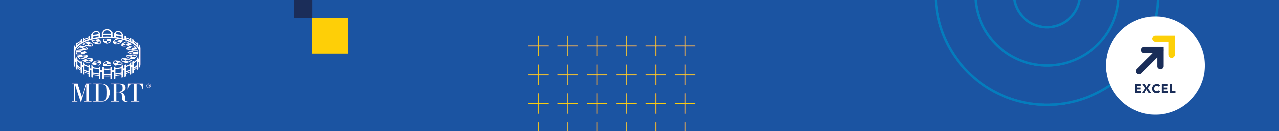
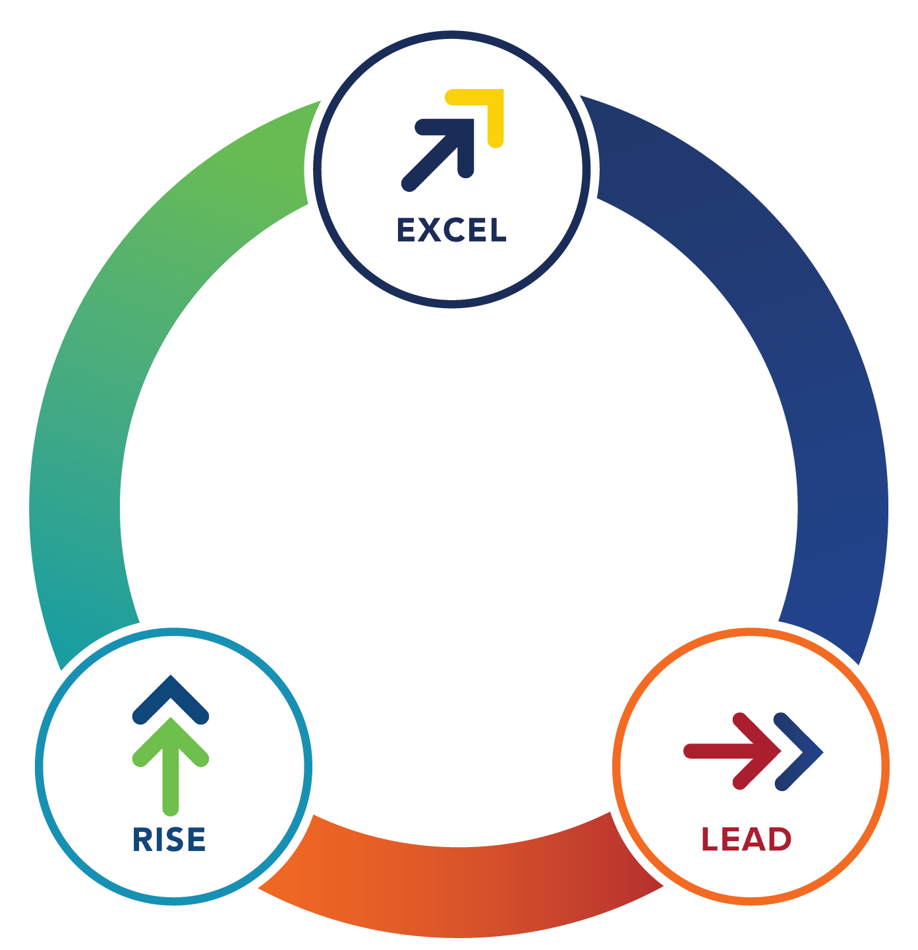
The MDRT Family of Brands
Equips financial services professionals to
Rise. Excel. Lead.
Throughout every stage
of their career journey.

Slide 3
What is the mission of MDRT?
A community of continued excellence dedicated to aiming higher and achieving more, MDRT is where financial services professionals surround themselves with the best in the business — and where they’re inspired to continue learning, achieving and celebrating each level of success.
MDRT offers proven methods and best practices for growth from top-tier advisors around the world. By collaborating daily with advisors who uphold exceptional professional knowledge, client service and ethical standards, your advisors will refine their skill sets, bring more value back to your organization and inspire collective success.
MDRT is the Premier Association of Financial Professionals®.
Membership
Requirements
Meet MDRT Production Requirements listed on mdrt.org/join
Join anytime
Open enrollment is November 1 to March 1, annually

Slide 4


“There are challenges in every business. And MDRT provides you with a network of people with the shared problems and shared opportunities where you can share ideas and insights to really help lift your business to the next level.”
Dana Mitchell, CFP, CLU

Slide 5
MDRT benefits to your business:
MDRT members set a high bar for professional knowledge, client service and ethical standards — positioning your company to stand out in a crowded field. You’ll attract qualified leads and clients who seek the best service and results from their advisors.
MDRT members are supported and challenged through all stages of their careers. A sales team with a high percentage of MDRT members reflects a strong work ethic, high standard for excellence and a focus on internal development within a company that drives toward success. An MDRT member builds trust with their clients through adherence to the MDRT Code of Ethics and has many opportunities to develop their leadership skills through mentorship, speaking at MDRT events and volunteering on MDRT committees, to name a few.

Slide 6
Engagement opportunities for MDRT members:
MDRT has a long-standing tradition of building and upholding exceptional knowledge, client service and ethical standards through access to career-changing ideas from a supportive network of peers and an unparalleled mix of content and resources featuring proven methods and best practices for growth.
The MDRT Annual Meeting gathers thousands of members from around the world to stimulate growth through learning, networking and sharing innovative ideas. Attendees hear inspiring speakers, learn insights from some of the best minds in the world, and share their best practices and innovations with peers to help attain new levels of success.

Slide 7
Exclusive content:
MDRT members have exclusive access to a supportive network that equips them with career-changing ideas as well as the opportunity to create genuine connections to adapt, grow and stay accountable. They can engage with an unparalleled mix of content, best practices and the collective knowledge of MDRT members worldwide.
By using MDRT’s unique Whole Person assessment, members not only become better advisors but better people — finding fulfillment beyond business and demonstrating a commitment to personal and professional development.

Slide 8


“MDRT is an organization that is well worth joining. I found that in the weeks following attending an MDRT meeting, I have closed new business that has more than made up for my investment in MDRT. I think you’ll find the same also. It’ll provide you with ideas and strategies that will help you become a better financial professional and help better serve your clients.”
Manuel L. Soliz Jr., FICS

Slide 9

Visit mdrt.org to learn why MDRT is the association for professionals who aspire for more.

