Slide 1




Slide 2

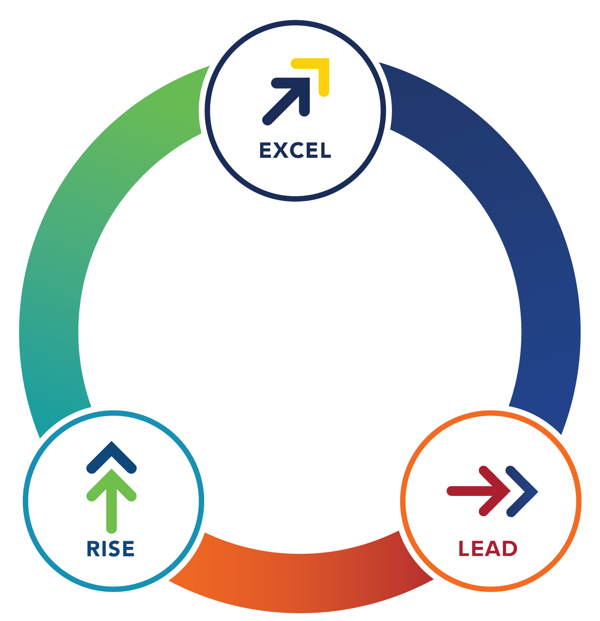
The MDRT Family of Brands
Equips financial services professionals to
Rise. Excel. Lead.
Throughout every stage
of their career journey.

Slide 3
What is the mission of MDRT Academy?
The MDRT Academy was built with a singular focus: helping your advisors go further than they ever thought, faster than they ever imagined, while becoming finer at their craft. With the culture, member expertise and best practices of MDRT behind the offerings, producers can achieve sustainable levels of production and attain MDRT status.
Master best practices from the best in the business.
Membership
Requirements
Advisors who aspire to qualify
for MDRT
Join anytime
Apply for 2023 membership
beginning November 1
Company involvement
Group membership

Slide 4

“The Academy was huge for me because, for any young financial advisor, the biggest roadblock, I think, is lack of confidence. Having a one-stop shop to really hear from the top financial advisors in the industry was huge.”
Brandon Heckert

Slide 5
Benefits to your business:
Complements company/product training efforts by introducing an Assessment and behavior-changing tools to build strong sales, client management and prospecting systems
Access to best-in-class content, discussions and productivity-enhancing resources from MDRT members
Improves new-advisor retention and accelerates producer growth, leading to sustainable performance
Provides an infusion of motivation to producers who have plateaued
One-on-one mentoring with experienced members via the MDRT Mentoring Program

Slide 6
Benefits to your advisors (MDRT Academy members):
MDRT-quality resources and support
Personalized membership journey
Goal-setting and -tracking features
Rewards and recognition
Access to MDRT events
Enhanced credibility through connections to MDRT

Slide 7
Exclusive content:
The MDRT Academy library is an ever-growing collection of personalized articles, videos and Webcasts to help members develop professional skills to go above and beyond in the financial services profession.
The MDRT Academy combines the value of an association membership with the convenience and accessibility of a mobile app. Members are guided to content via the MDRT Academy App based on the results of an Assessment of their strengths in 15 areas deemed by MDRT members to be critical to long-term success.
Members have access to Critical Mindsets, in-depth Performance Guides and other tools to help propel your performance.

Slide 8

“We’ve seen in the industry, fewer organizations, fewer traditional insurance carriers or broker-dealers that are providing a really deep level of training, mentoring and development in the first three to five years of their business. So, for MDRT to create this Academy to help newer, younger members grow and be successful is fantastic because we can provide a resource in the industry that I think is lacking and really create that next generation of advisors in the global community.”
Brendan Clune Walsh

Slide 9
Visit mdrtacademy.org to see why the MDRT Academy is where good advisors become great.

